Slide 1
Body Image and Intimacy
Staying in the Circle of Life
Session 5

Slide 2
Welcome
Notes:
*Go Around…

Slide 3
Agreements
We want to do what we can to make sure everyone feels comfortable while they’re here. Some examples:
Keep it confidential - everything anyone says stays in the room
Listen with respect
Stay on topic – we have a lot of information to go over and we want to make sure we cover it all
Other things we can do?
Notes:
* Tool: “Popcorn”
* Explain what they are and why they’re important
* Bring in concept of “parking lot” (or alternate term)

Slide 4
What We Will Talk About Today
Changes we have seen or felt in our bodies
The effect of these changes on our daily lives
The impact of cancer and cancer treatment on intimacy
Communication with partners and doctors about intimacy
Notes:
Include as talking point in guide - What are some goals we can have to feel good about our bodies? Identifying ways to resolve intimacy issues

Slide 5
Why are we talking about body image?
Cancer and cancer treatment can lead to many changes:
Changes in how our bodies look
Changes in how our bodies work
Changes in how we feel about our bodies
It’s important to understand how we feel about these changes.
It’s also important to learn to love our bodies the way they are.

Slide 6
Have you noticed changes in your body?
For some people, physical changes might include:
Hair loss
Weight loss or weight gain
Tooth loss
Scars
Some people find that physical changes also lead to changes in their daily lives. These might include:
Finding it hard to meet new people
Trying to hide their bodies and things that have changed from friends and partners

Slide 7
What do our bodies look like now?
What’s different about my body?
How do I feel about the changes in my body?

Slide 8
How can we feel good in our bodies?
Keep a positive self-image
Be active
Wear clothes that make you feel good and comfortable
Take care of your skin
Talk to your friends and family
Look into support for hair loss or change (wigs, hats, scarves)

Slide 9
Activity
Conduct Art Expression
Describe the Mirror Activity
Notes:
Arm shake activity
Separate into gender groups

Slide 10
Break

Slide 11
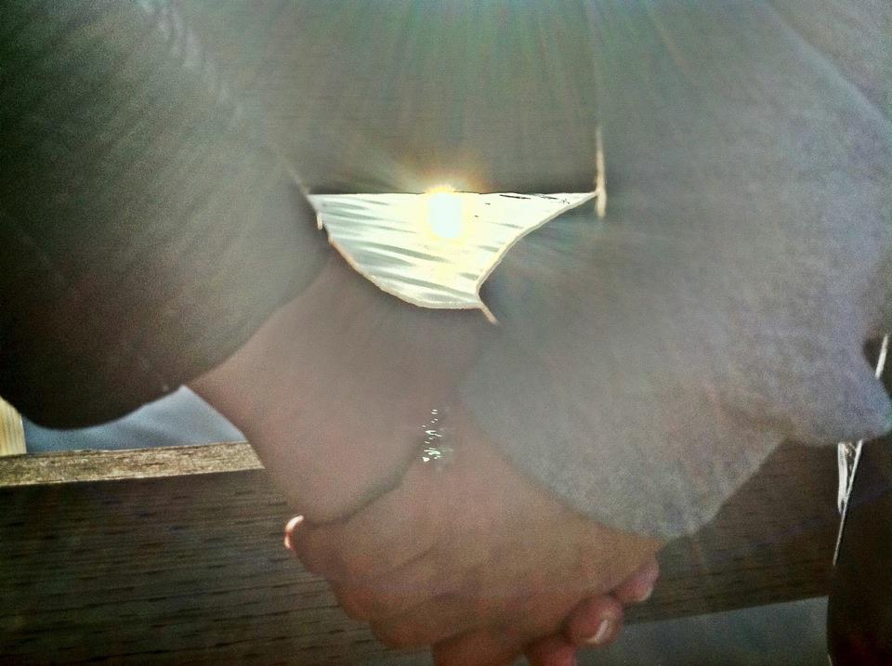
What comes to mind when you hear “intimacy”?
We are going to discuss how cancer and treatment affect intimacy, including –
Identifying ways to resolve intimacy issues
Practicing communication with doctors and partners
Learning how to talk about intimacy after cancer
Notes:
Intimacy involves more than just sex, it involves being close, sharing and supporting.

Slide 12
Sources of intimacy problems
Treatment effects
Worries
Self-perceptions of sexuality
Partners’ reactions
Fatigue
Relationship challenges
Stress

Slide 13
How can we feel good about ourselves and our strengths?
Change negative thoughts
Eat healthy foods
Be physically active
Deal with grief and loss
Notes:
Note: previous strategies described in the stress management and coping

Slide 14
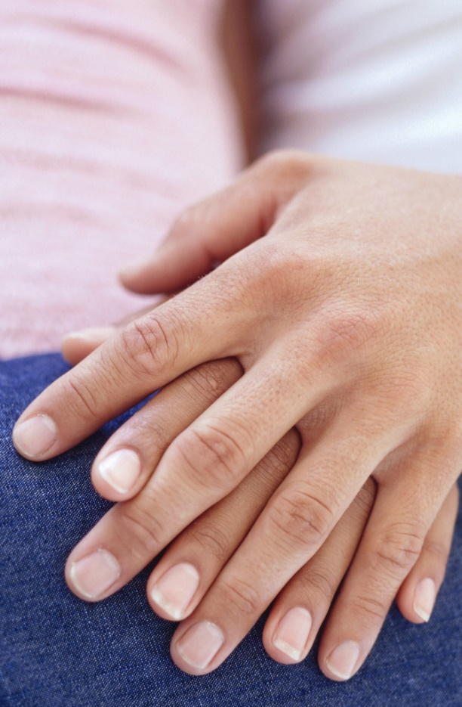
How can we work with our partners to encourage intimacy?
Be comfortable with yourself
Talk to each other
Maintain touch and be affectionate

Slide 15
Activity
What are some changes you’ve noticed about your body?
What are some steps you can take to have a positive view of yourself and your body?
What have you done to address intimacy or intimacy concerns with your partner?
Notes:
* Go Around – have people write this down – share if comfortable
* Ok if you don’t cover them all or add others that come up during session

Slide 16
Things to Think About
Cancer can affect intimacy, sexuality, and sex.
Intimacy, sexuality, and sex are important to help you find your “new normal.”
Communicate with your partner about how you feel and what you need.
Feel comfortable with your own body.
We can (and should) still feel good about our bodies!
Notes:
Talking point - It’s common to have changes in our bodies, Some changes effect how we complete daily tasks and our self-esteem

Slide 17
Closing Circle
Notes:
*Guiding prompt: I learned/I hope/ I feel/
* Go around

