Slide 1
Stress and Stress Management
Staying in the Circle of Life
Session 2

Slide 2
Welcome and Introductions
Notes:
Go Around…

Slide 3
Agreements
We want to do what we can to make sure everyone feels comfortable while they’re here. Some examples:
Keep it confidential - everything anyone says stays in the room
Listen with respect
Stay on topic – we have a lot of information to go over and we want to make sure we cover it all
Other things we can do?
Notes:
* Tool: “Popcorn”
* Explain what they are and why they’re important
* Bring in concept of “parking lot” (or alternate term)

Slide 4
What We Will Talk About Today
What is stress?
How you can identify stress
How people experience stress
How you can manage stress

Slide 5
What is Stress?
Everyone experiences stress at some time or other.
The important thing is to keep stress in balance.
Too much stress can have negative consequences for your health.
However, stress can be a positive thing in small doses.
Stress can motivate us to make positive changes in our lives.

Slide 6
Who Feels Stressed?
Everyone affected by cancer will probably feel stress:
Cancer patients and survivors
Family members
Caregivers
Friends
Healthcare providers
Community health representatives
Notes:
* Insert a story (facilitator can share his or her own story, or read a story, or play a digital story)
* Prompt other suggestions

Slide 7
Common Symptoms of Stress
Physical
Stomach pain
Headaches
Difficulty concentrating
Feeling tired or unable to sleep
Emotional
Feeling afraid or worrying more than usual
Feeling angry or irritable
Feeling helpless or hopeless
Feeling restless
Crying a lot
Mental
Feeling overwhelmed or out of control
Having low self-esteem
Not enjoying things that you used to enjoy
Spiritual
Feeling out of balance
Feeling no sense of purpose
Others?

Slide 8
Some Cancer-Related Causes of Stress
Receiving a cancer diagnosis
Getting treated for cancer
Having to leave family for medical care
Experiencing financial issues - paying bills, getting back to work
Fearing that cancer will come back
Feeling tired all the time
Having intimacy issues
Getting back to “normal”
Adjusting to “new normal”

Slide 9
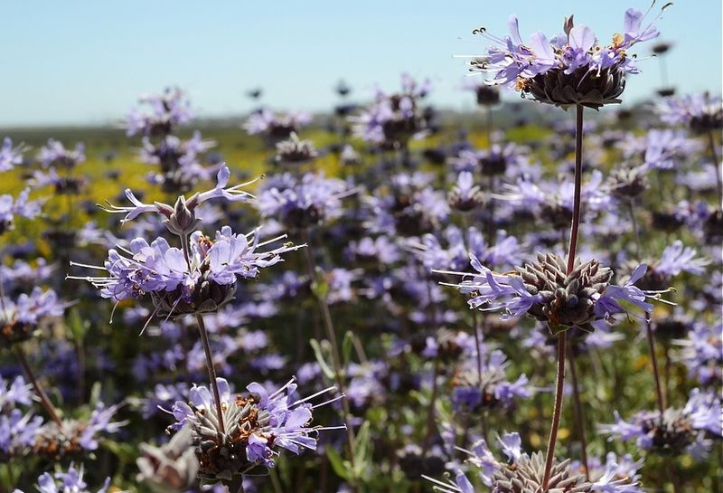
Break

Slide 10
Healthy and Unhealthy Ways to Manage Stress
Unhealthy
Alcohol or drugs
Smoking
Aggression
Gossiping
Yelling (can be healthy too, depending on what you’re yelling at ☺)
Eating unhealthy food
Breaking things
Others?
Healthy
Asking for and receiving help
Exercise
Laughing
Setting goals
Resting
Listening to music
Taking warm baths
Visiting with family or friends
Asking for and accepting support
Others?
Notes:
* Have them brainstorm a list for “healthy” and “unhealthy” before showing them examples…
or
* Make a list of all the words above without categories and have participants put them into categories?
** Talking Points: It is normal to feel stress, anxiety, sadness or fear when a stressful event occurs. It can take time to adjust to changes and return to a normal routine.
It is important to find healthy ways to address your feelings before they become overwhelming

Slide 11
A few suggestions...
Keep a diary or journal. Try writing down your feelings, making drawings, or keeping track of activities or events that you’ve been part of.
Talk to someone. Holding in your feelings can make things harder than they need to be. Try talking to a friend, family member, or someone else you trust who will listen!
Call on your traditional teachings. Remember to take care of your spirit. If you need to, ask your family, a spiritual leader, or a traditional healer to help you find balance to help you through tough times

Slide 12
Activity
Deep Breathing Exercise

Slide 13
Stress Management
Physical
Mental
Being physically active
Laughing
Listening to music
Meditating
Deep breathing
Emotional
Spiritual
Laughing
Resting
Listening to music
Setting goals
Sweating
Praying

Slide 14
Discussion Questions
Does talking about stress make you feel stressed?
How do you experience stress?
What are some ways you relieve stress?
Notes:
* Go around and ask participants to respond
* It’s okay if you don’t cover all these questions, and it’s okay to add others that come up during session
* If time permits
* Make a list of questions for the manual. The main purpose of the list is for facilitators to have questions on hand in case people aren’t interacting on their own

Slide 15
Things to Think About
There are many things that can cause stress
Stress can be a positive thing when kept in balance
You have control over how you handle to stress
There are healthy and unhealthy ways to handle stress
You can improve your mental, emotional, spiritual and physical health by practicing healthy stress management

Slide 16
Closing Circle
Notes:
* Guiding prompt: I learned/I hope/ I feel/
* Go around
* If time is short, limit responses to “what is one word to describe…” Otherwise, let them talk as they want.

